Slide 1
Project Title
Machine Learning for Cybersecurity Threat Detection and Prevention
Presented by:
Ayobella Adeniran

Slide 2
Significance of research
Cybersecurity is a critical concern in the digital age, with increasing incidents of sophisticated cyber attacks threatening individuals, businesses, and governments.
This research aims to explore and understand the role of Machine learning in cybersecurity, with focus on threat detection and prevention so as to better advise on the effectiveness and efficiency of these defense mechanisms as opposed to traditional cybersecurity models.

Slide 3

Contribution to Academia
Academically, this research will further aid an understanding of the intersection between Machine Learning and cybersecurity. It will provide a detailed review of current literature, identify gaps, and propose novel methodologies for threat detection and prevention.

Slide 4
Contribution to professional practice
This research aims to bridge this gap by providing a comprehensive analysis of ML techniques tailored to cybersecurity. By focusing on journals and articles written by both academic and industry based professionals, this study will enrich the existing body of knowledge, offering new insights and frameworks that can be utilized by researchers and practitioners alike.

Slide 5
Research Problems
There still exists a gap between this progress and it’s utilization in cybersecurity threat detection and mitigation (A. Karim et al, 2019)
There is a lack of standardization in creation of cybersecurity datasets and absence of robust and adaptable models designed specifically for cybersecurity. (Rashid M. M. et al, 2022)
The complexity of malware attacks seem to be matching the growth in the combating forces and this is a call to attention for researchers and cyber enthusiasts. (A.A. Srinivas, 2023)

Slide 6

Research Question
How can machine learning techniques be utilized to improve the detection and prevention of cybersecurity threats, and what are the practical challenges associated with their implementation?

Slide 7
Aims and Objectives
This study aims at investigating and developing an advanced machine learning model for effective cybersecurity threat detection and prevention.
Objectives
To understand how effective machine learning has been in the detection and prevention of threats in cybersecurity.
Furthermore, we hope to identify the major challenges and drawbacks in the application of these techniques.
Also, this research will analyse the impact of these issues on the utilization of Machine learning models in the cybersecurity space.
Lastly, we will develop a hybrid machine learning model that will address the problems identified in the research problems, as well as adding new contributions to the practice of cybersecurity.

Slide 8

Key literature related to the project
Definition of Machine Learning
Importance of Machine Learning
Types of Machine Learning models
Cybersecurity: an overview
Traditional Cybersecurity tools
Machine Learning in Cybersecurity threat detection

Slide 9
Research Design
Literature Review
Data Collection
Model Selection and Training
Evaluation.
Hybrid Machine Learning model Development and Testing
Case Studies

Slide 10
Ethical considerations and risk assessment
Informed Consent
Data Privacy
Bias and Fairness
Security Risks
Transparency

Slide 11
Description of proposed artefact(s)
Comprehensive Literature Review
Evaluation Reports
Hybrid machine learning model

Slide 12
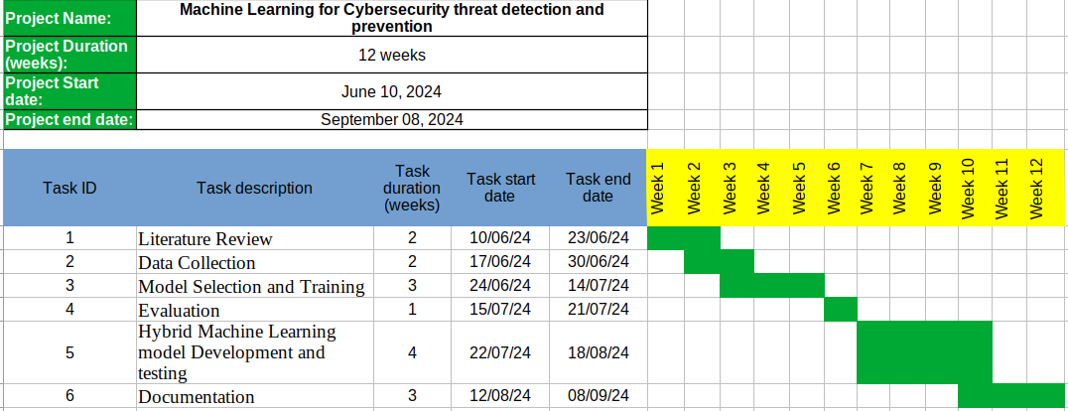
Timeline of proposed activities

Slide 13
References
Bharadiya, J., 2023. Machine Learning in Cybersecurity: Techniques and Challenges. Eur. J. Technol. 7, 1–14. https://doi.org/10.47672/ejt.1486
Bi, Q., Goodman, K.E., Kaminsky, J., Lessler, J., 2019. What is Machine Learning? A Primer for the Epidemiologist. Am. J. Epidemiol. kwz189. https://doi.org/10.1093/aje/kwz189
Botacin, M., Ceschin, F., Sun, R., Oliveira, D., Grégio, A., 2021. Challenges and pitfalls in malware research. Comput. Secur. 106, 102287. https://doi.org/10.1016/j.cose.2021.102287
Elsaeidy, A.A., Jamalipour, A. and Munasinghe, K.S., 2021. A hybrid deep learning approach for replay and DDoS attack detection in a smart city. IEEE Access, 9, pp.154864-154875.
Gibert, D., Mateu, C., Planes, J., 2020. The rise of machine learning for detection and classification of malware: Research developments, trends and challenges. J. Netw. Comput. Appl. 153, 102526. https://doi.org/10.1016/j.jnca.2019.102526
Karim, A., Azam, S., Shanmugam, B., Kannoorpatti, K., Alazab, M., 2019. A Comprehensive Survey for Intelligent Spam Email Detection. IEEE Access 7, 168261–168295. https://doi.org/10.1109/ACCESS.2019.2954791
Rashid, M.M., Kamruzzaman, J., Hassan, M.M., Imam, T., Wibowo, S., Gordon, S. and Fortino, G., 2022. Adversarial training for deep learning-based cyberattack detection in IoT-based smart city applications. Computers & Security, 120, p.102783.
Saba, T., Khan, A.R., Sadad, T. and Hong, S.P., 2022. Securing the IoT system of smart city against cyber threats using deep learning. Discrete Dynamics in Nature and Society, 2022.
Spring, J.M., Fallon, J., Galyardt, A., Horneman, A., Metcalf, L. and Stoner, E., 2019. Machine Learning in Cybersecurity: A Guide. SEI-CMU Technical Report, (5).
Vaddadi, S.A., Vallabhaneni, R. and Whig, P., 2023. Utilizing AI and Machine Learning in Cybersecurity for Sustainable Development through Enhanced Threat Detection and Mitigation. International Journal of Sustainable Development Through AI, ML and IoT, 2(2), pp.1-8.

